Slide 1

Or
This?
Confidence in every choice.
AI-powered outfit feedback in 30 seconds. Your honest friend in your pocket.
Seed Stage • 2026

Slide 2

THE PROBLEM
Every morning, millions of women stand in front of the mirror and ask: "Does this actually look good?"
I was a signed model. Getting dressed for shoots and auditions was high-stakes
And I still had nobody honest to ask.
That experience is universal. Every woman faces it. Every man faces it. No good solution exists.
— "I just want someone honest to tell me if this works."

Slide 3
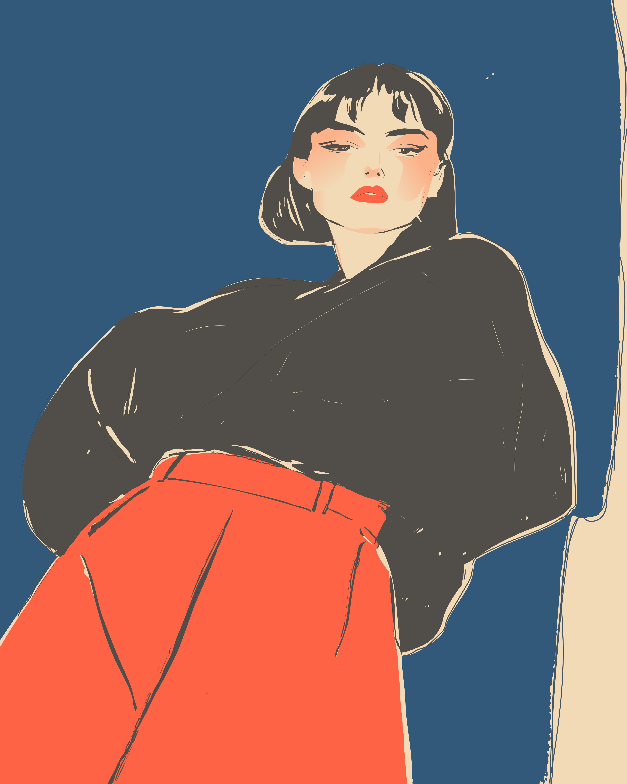
THE SOLUTION
Your honest friend in your pocket.
01
Snap
Full-body photo or selfie.
02
Context
Occasion, setting, vibe.
03
Feedback
AI analysis in 30 seconds.
04
Conversation
Follow-ups like a friend.
Not inspiration. Not shopping. Just honest, instant, private feedback.

Slide 4
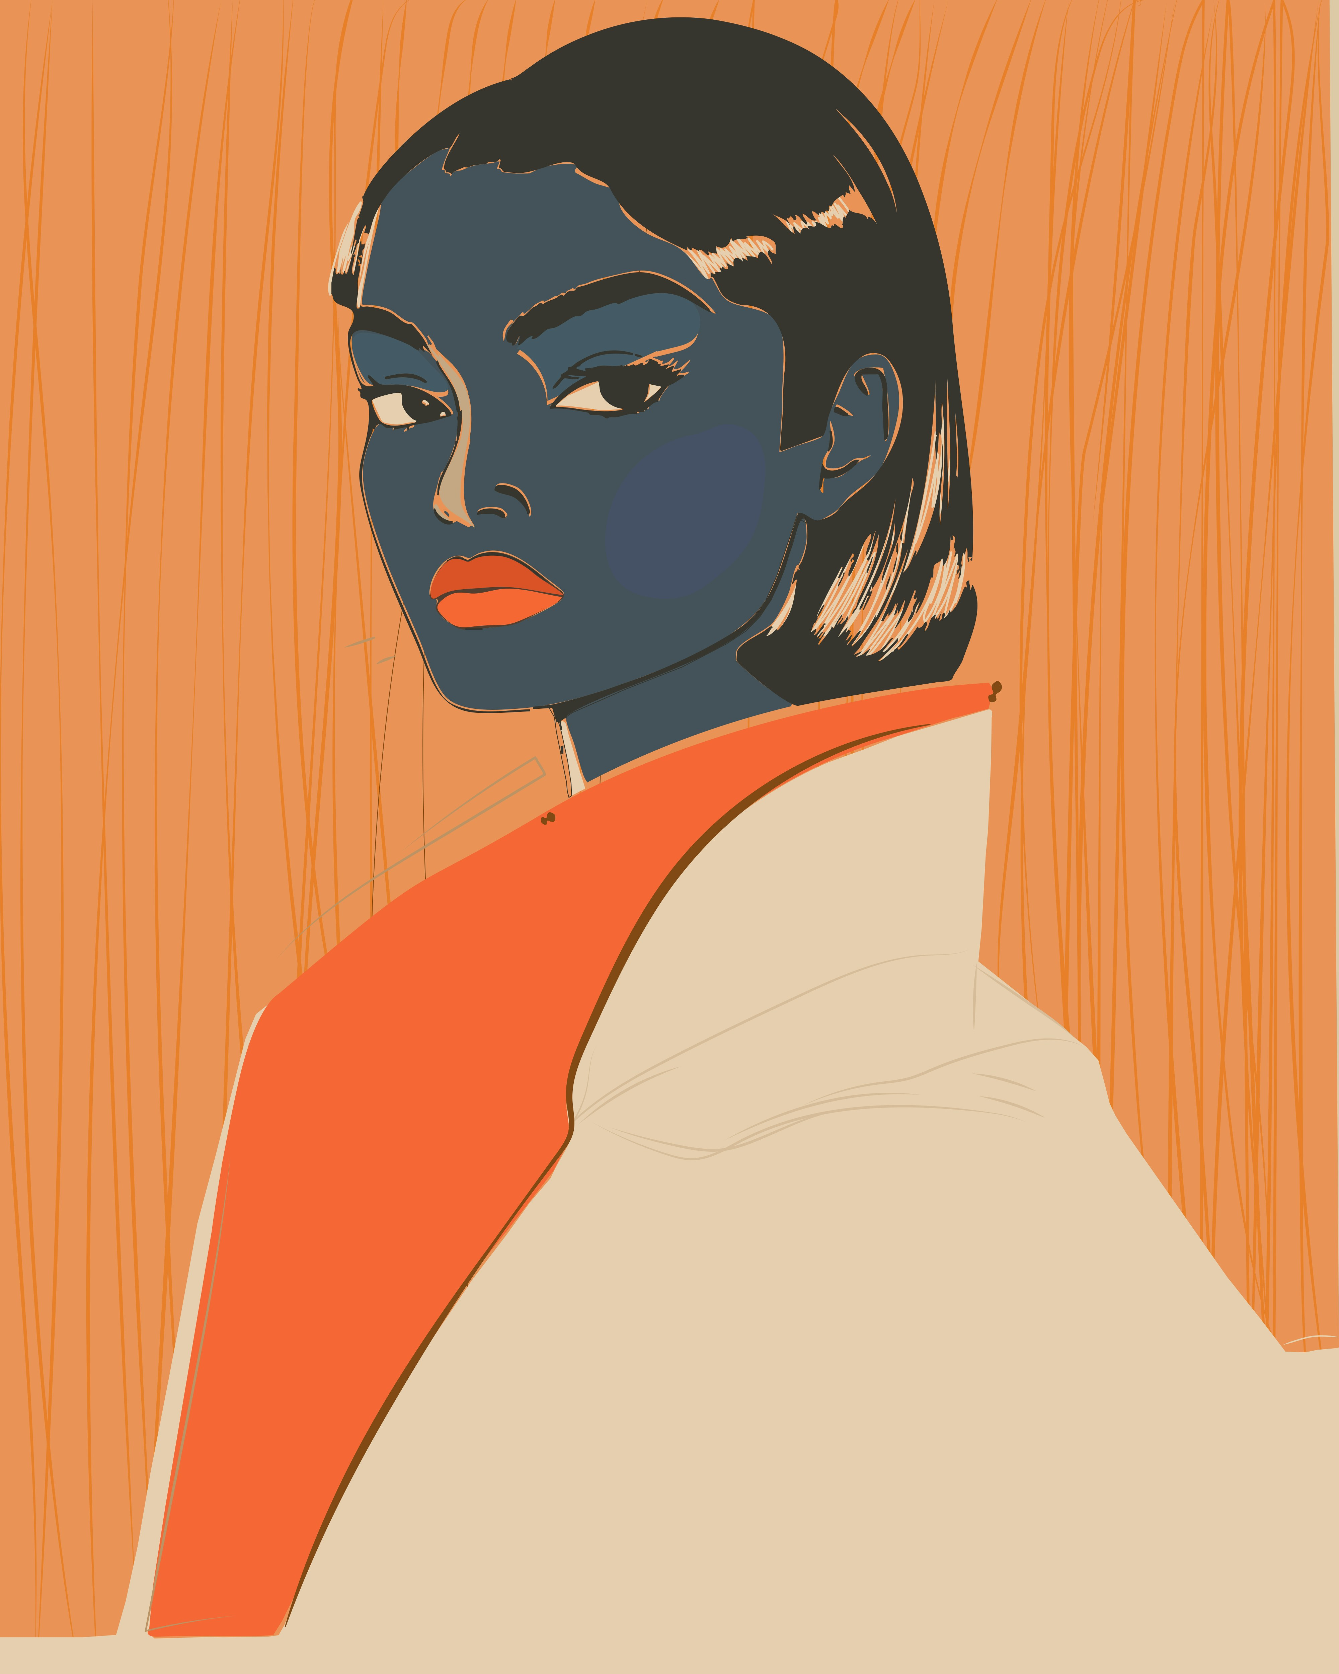
THE AI
It tells you the truth.
A Vogue editor in your pocket — powered by vision AI.
— A score out of 10. No sugarcoating.
— What's working — specific, actionable.
— What to reconsider — honest, constructive.
— Quick fixes you can change in 2 minutes.
— Keep asking until you're sure.
It learns you: Style DNA builds with every check — color harmony, fit patterns, garment history. The longer you use it, the sharper it gets
Built-in fashion expertise: Color theory · Proportions · Fit · Dress codes · Seasonal trends · Body type · Color season
Self-improving AI: 7-stage automated training pipeline · Prompt v3.0 · Self-calibrating against community ratings

Slide 5
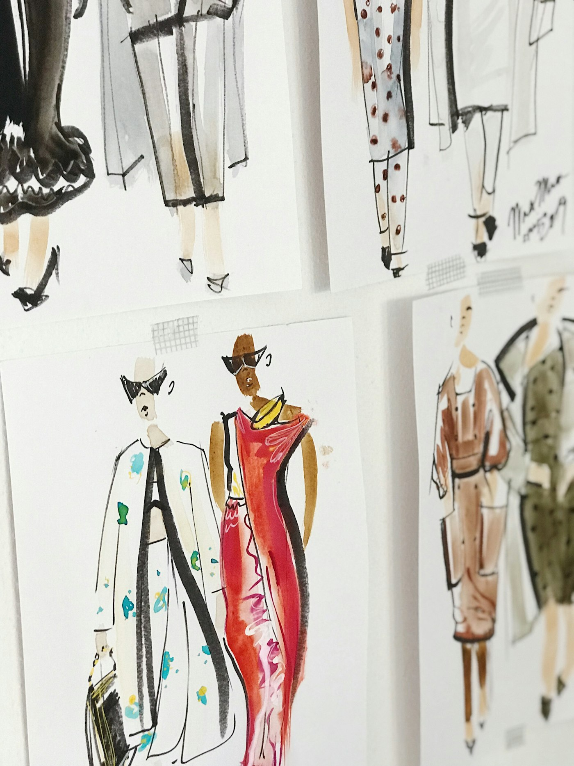
MARKET OPPORTUNITY
A massive, underserved market at the intersection of fashion and AI.
TAM
SAM
SOM
$1.8T
$5.5B
$200M
Global fashion market
Women's styling & fashion apps
AI outfit feedback (Year 5)
Why now? Vision AI crossed the quality threshold in 2023–24. And every outfit we analyze becomes a permanent, structured data asset that compounds in value — a moat no competitor can replicate without our user base.

Slide 6

FASHION INTELLIGENCE
The consumer app is the data collection engine.
Every outfit check generates structured fashion intelligence no competitor can replicate without the same user base.
CAPTURED PER CHECK
AT SCALE
B2B REVENUE
— StyleDNA attributes
— Color harmonies & palette
— Occasion + setting patterns
— Garment categories & frequency
— AI score + community signal
— Trend velocity signals
Real-time, bottom-up dataset
What real people actually wear —
not what they say they wear.
AI-scored. Community-validated.
Queryable by demo, occasion, geo.
No competitor can replicate it
without our user base.
Trend reports
$15–50K / quarter
Custom brand research
$25–100K per study
Real-time trend API
$5–20K / month
White-label styling SDK
$10–50K / month
→
→
Comparable: WGSN earns ~$100M+ ARR selling fashion intelligence built on runway predictions and surveys. Ours is built on what real people actually wear.

Slide 7

BUSINESS MODEL
Freemium with a clear upgrade path.
FREE
PLUS
PRO
$0
$4.99/mo
$14.99/mo
3 AI checks / day
3 follow-ups per check
7-day history
Ad-supported
Unlimited AI checks
5 follow-ups per check
Full outfit history
No ads
Community feedback
Everything in Plus
10 follow-ups per check
5 expert reviews / month
Event planning mode
Style analytics & DNA
Layer 2 — Fashion Intelligence (B2B): Trend reports • Trend API • White-label SDK • Custom research — highest-margin revenue at scale

Slide 8
UNIT ECONOMICS
AI costs drop. Our margins improve. Every quarter.
~$0.003
~$0.50
$4.99–$14.99
10–30x
Cost per AI check
Blended monthly cost per user
Monthly revenue per paid user
Target LTV:CAC
Gemini Vision API cost per analysis
Including infra, storage, AI calls
Strong gross margins on subscriptions
Organic-first acquisition
AI API costs have dropped 90% in 18 months and keep falling. Our COGS improves automatically — the opposite of most consumer businesses.

Slide 9
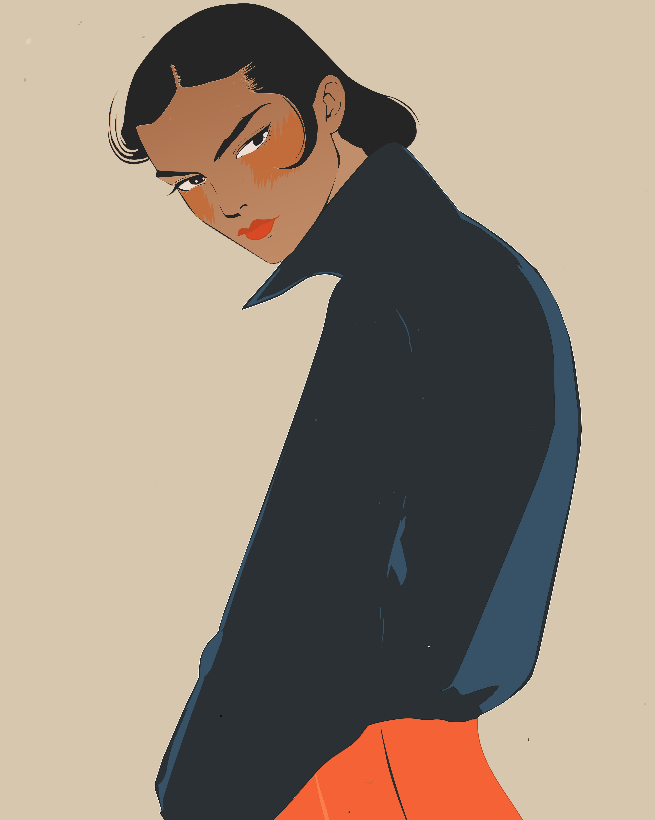
GROWTH
"Or This?" is inherently shareable.
Built-in virality. Every outfit is a potential share.
The core loop:
1. User gets feedback → tells friends
2. A/B comparisons shared for votes
3. Friends download to participate
4. New users try AI → get hooked
5. Every outfit = potential share
Go-to-market:
— TikTok / Reels
— Reddit (2M+ members)
— Micro-creator seeding
— Word of mouth
Launch:
— Private beta → 500
— ProductHunt launch

Slide 10
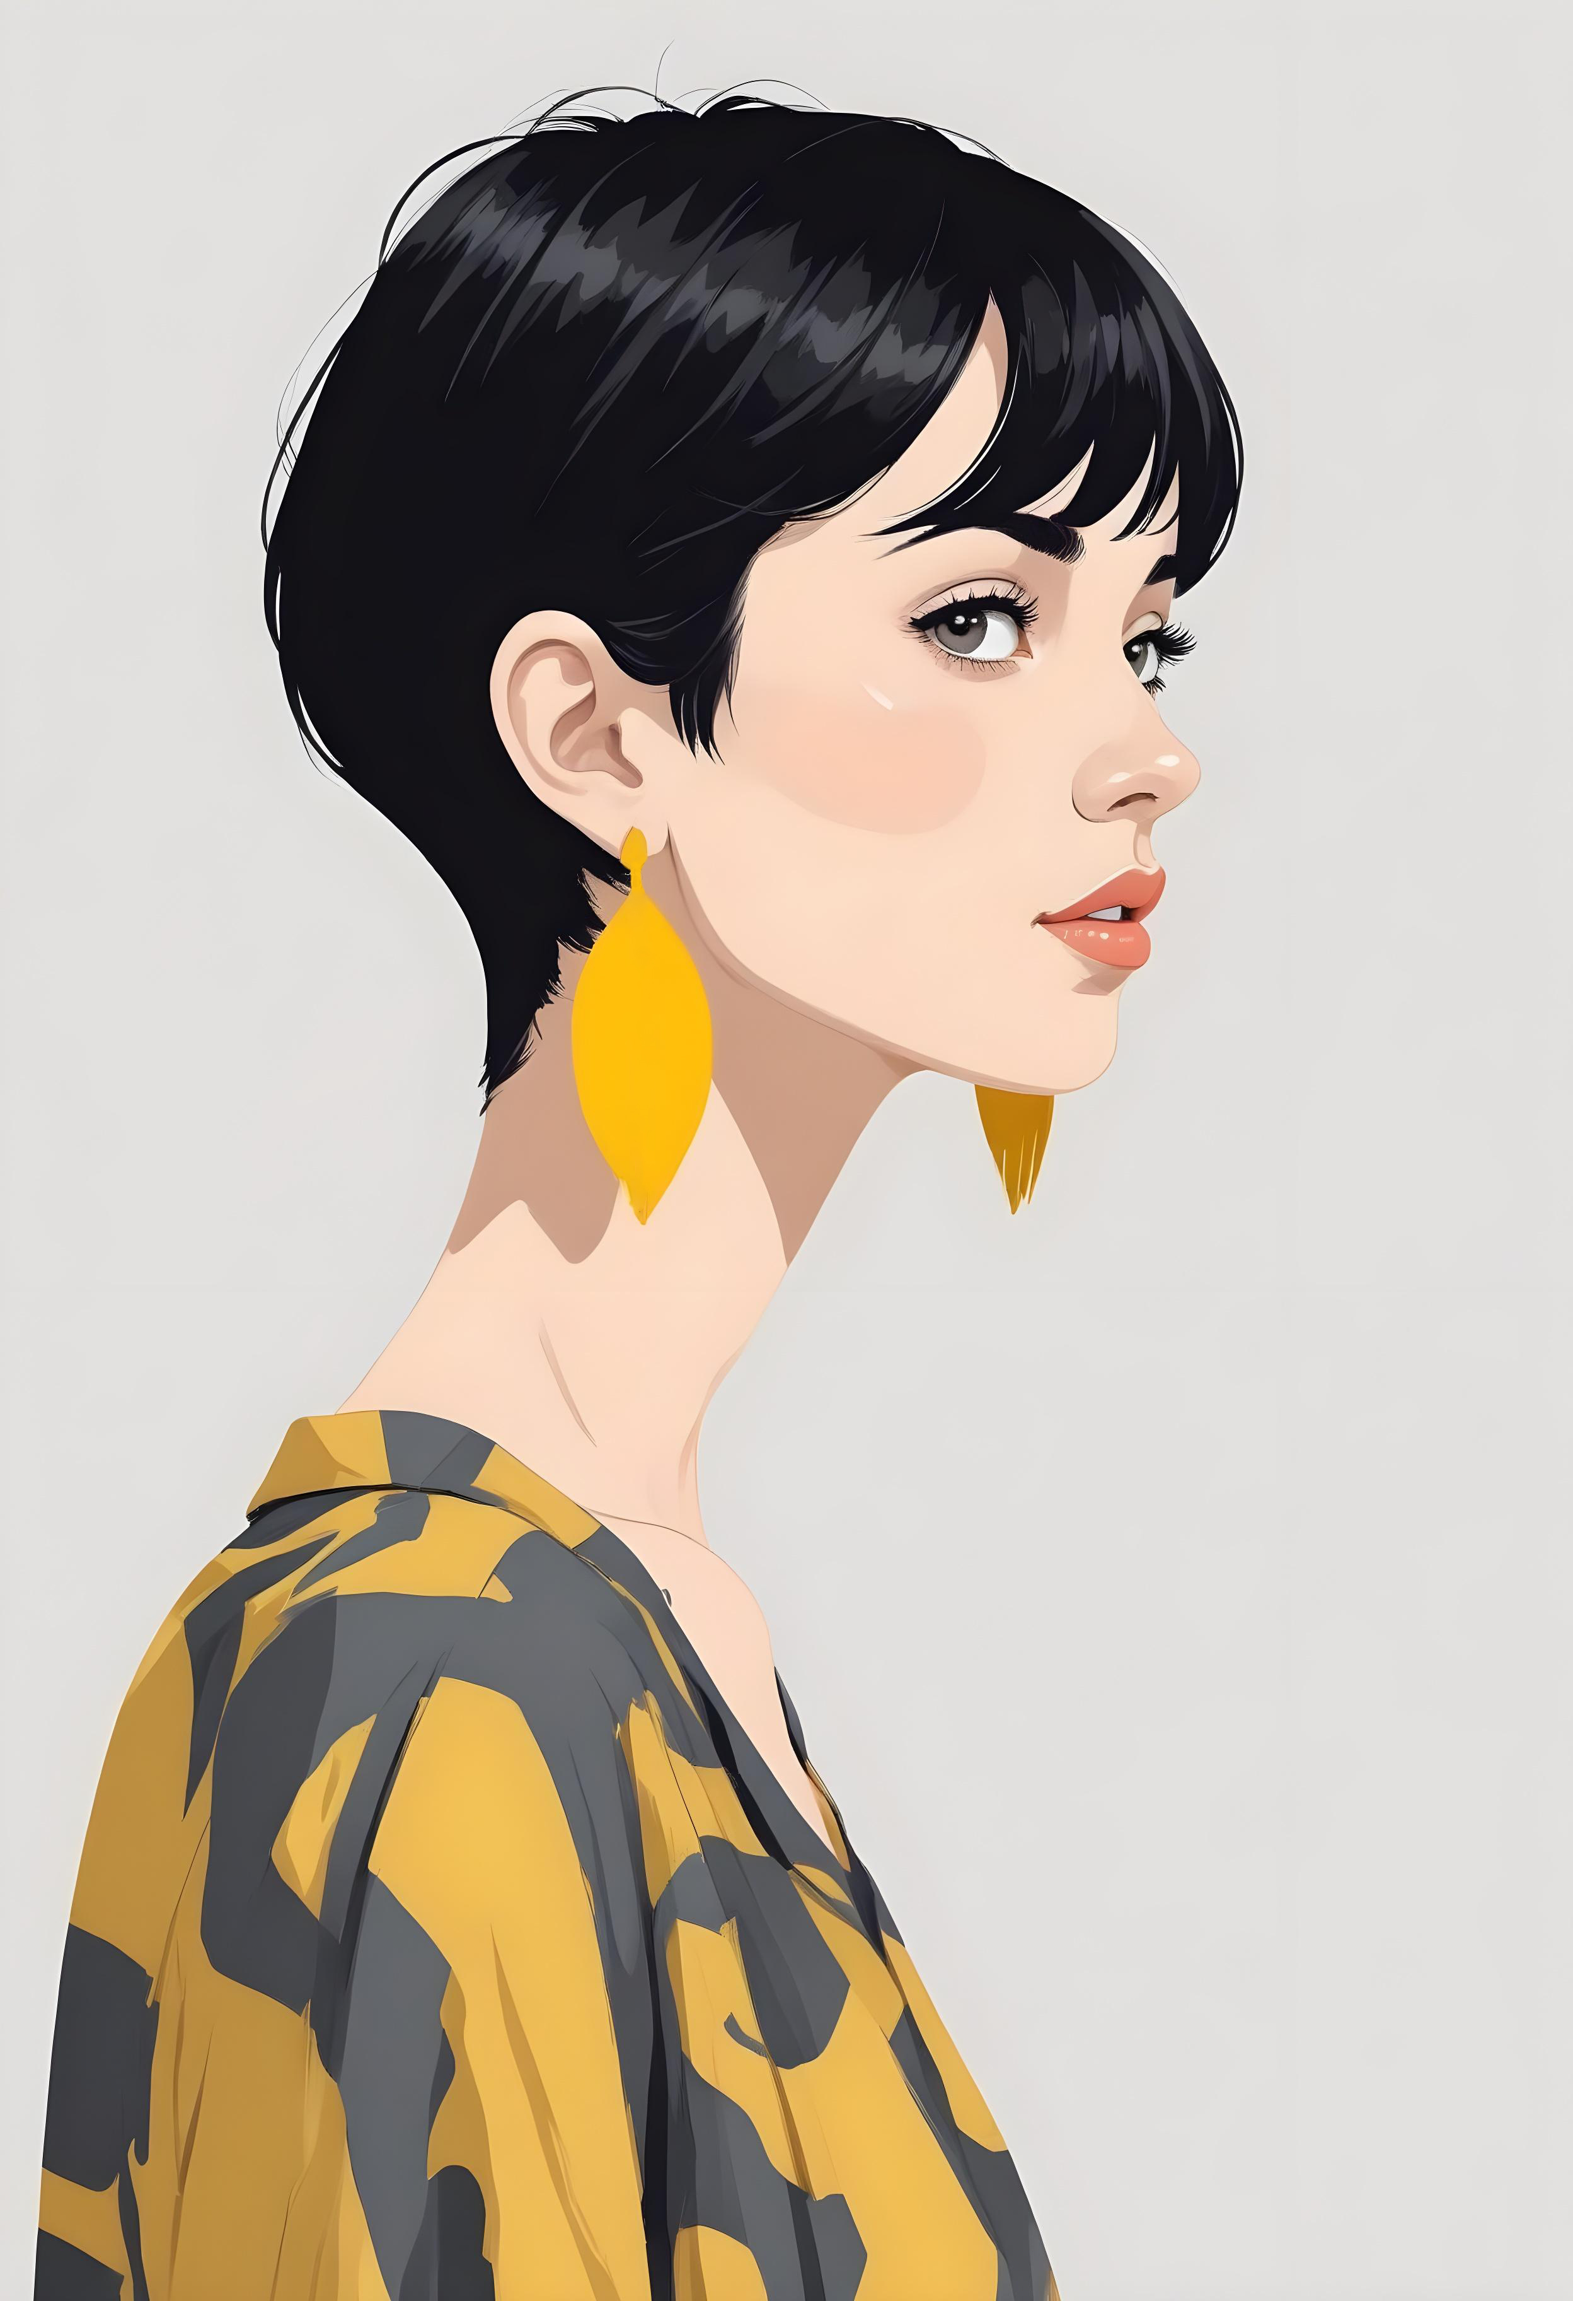
COMPETITION
We own the "moment of decision." Nobody else does.
Stitch Fix
Pinterest
ChatGPT
Or This?
Subscription boxes.
Inspiration.
General AI.
Instant AI feedback at the moment of decision.
Days, not seconds. Expensive.
Not feedback. Not private.
No fashion expertise. No specialized UX.
Fast. Private. Expert. Always on.
Our moat: The world’s only real-time consumer fashion dataset — every outfit analyzed generates structured intelligence that compounds in value. Style DNA profiles that deepen over time. Community network effects.

Slide 11
TRACTION
Complete product built. Ready for users.
BUILT
DEPLOYED
READY
ACTIVE
Full-stack app
Backend live
App store
AI pipeline
37 screens 16 API domains 54+ database tables
Railway hosting PostgreSQL All services up
iOS + Android builds prepared
7-stage training Prompt v3.0
MONTH 6 TARGETS
50K
10K
30%
4.0 / 5
MAU
Daily checks
D7 retention
Helpfulness

Slide 12
ROADMAP
Nail the core. Then expand.
NOW
Q3 2026
Q4 2026
2027
Core Loop
Community
Monetize
Scale
— App store launch
— AI refinement
— Beta (500 users)
— Organic seeding
— Community feedback
— "Or This?" A/B
— Give-to-get flywheel
— Gamification
— Plus & Pro tiers
— Expert marketplace
— A/B test pricing
— Revenue optimization
— Video analysis
— Shopping integration
— Brand partnerships
— International

Slide 13



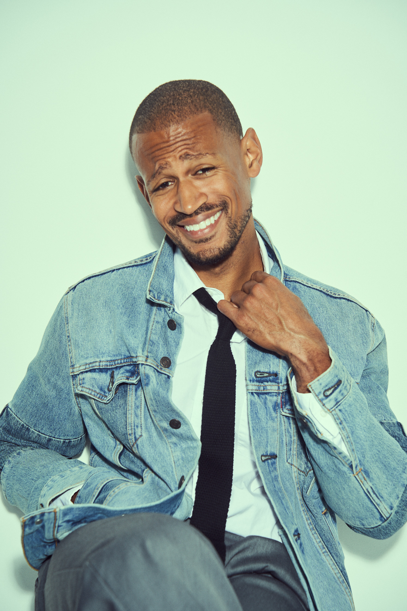



THE TEAM
Built by someone who understand the problem.
Brandon Davis
CEO / Product
Vassar College, Kellogg MBA
Kellogg MBA (Northwestern). Led program management at Apple (Health Technologies), Verily/Alphabet (Project Baseline), and Komodo Health, driving $15M+ in revenue across digital health and pharma
I spent years as a signed model and SAG actor in an industry where appearance is literally your professional product. I've stood in front of the mirror before auditions, shoots, and appearances knowing the stakes were real — and knowing there was no fast, honest resource to help. I built the app I needed then.

Slide 14
THE ASK
Raising $1.5M seed to launch and scale.
40%
25%
20%
15%
Engineering
Growth
AI / Data
Operations
Scale infra. Hire 2 engineers.
Creator partnerships. Launch.
Training pipeline. Style DNA.
Team. Legal. 18-mo runway.
18-MONTH MILESTONES
250K MAU • 75K daily checks • $1M+ ARR • Series A metrics

Slide 15
Or
This?
Confidence in every choice.
[founder@orthis.app] • orthis.app
Illustrations: Fabian Künzel-Zeller, Artby Hensi, Charlota Blunarova, Ribhav Agrawal

